Slide 1

Employee Management System
Presented By :
M.Nishanth Reddy
Batch No: 456

Slide 2
Agenda
Introduction
Objective of the Project
Database Tables Overview
ER Diagram
Relationship Between Tables
SQL Query Results
Challenges Faced
Final Business Insights
Conclusion

Slide 3
BUSINESS PROBLEM
Organizations face challenges in managing employee, salary, and leave data in a centralized system.
Lack of database integration limits visibility into department-wise workforce and payroll analysis.
Management requires clear insights into compensation, bonuses, and qualifications for informed decision-making.
Without analytical reporting, controlling payroll costs and workforce planning becomes difficult.

Slide 4
Introduction
The Employee Management System (EMS) is a SQL-based relational database project designed to manage and analyze employee-related data efficiently.
It integrates key components such as departments, job roles, salary structures, qualifications, leave records, and payroll processing into a centralized system.
The project applies core concepts like primary and foreign keys, normalization, constraints, joins, and aggregations to ensure data integrity and accurate reporting.
Through structured SQL analysis, the system provides workforce insights, compensation trends, and payroll analytics, supporting informed managerial decision-making.

Slide 5
Objective of the Project
Design a RELATIONAL DATABASE SCHEMA
Define PRIMARY & FOREIGN KEY RELATIONSHIPS
Import data from CSV FILES
Write ANALYTICAL SQL QUERIES
Perform HR & PAYROLL DATA ANALYSIS

Slide 6
Database – Tables Overview
1. EMPLOYEE
Personal details
Contact information
2. JOB_DEPARTMENTS
Department details
Job designations
3. QUALIFICATION
Skills
Certifications
4. SALARYBONUS
Salary
Bonus
Annual pay
5. LEAVES
Employee absence records
6. PAYROLL
Final salary calculation
Deductions applied

Slide 7
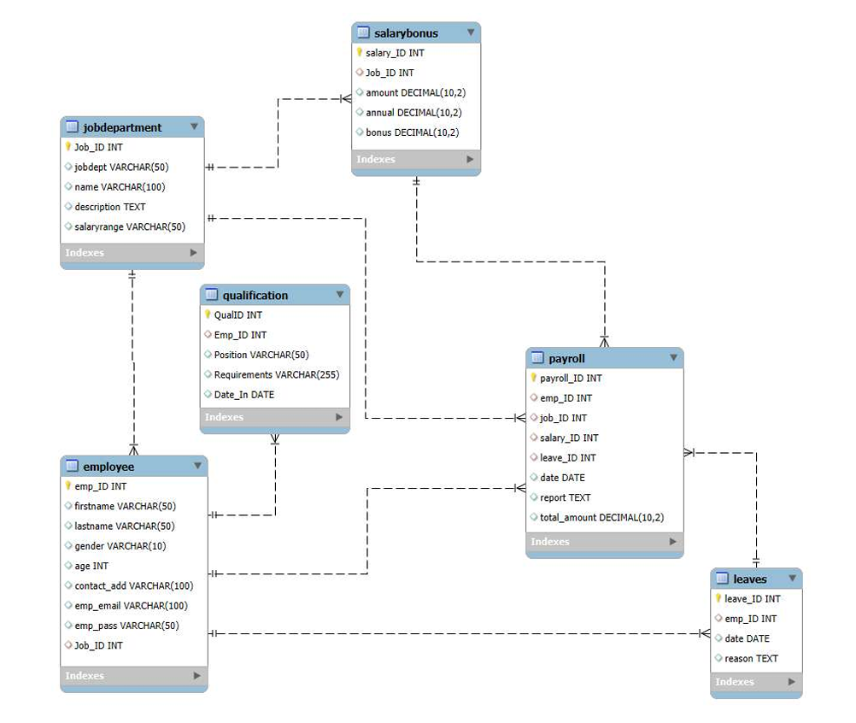
ER DIAGRAM

Slide 8
CARDINALITIES
The ER DIAGRAM shows the relationship between tables:
ONE-TO-MANY → Job Department → Employee
ONE-TO-MANY → Employee → Leaves
ONE-TO-MANY → Employee → Qualification
ONE-TO-MANY → Job Department → Salary Bonus
PAYROLL connects all major entities
Ensures DATA INTEGRITY & CONSISTENCY.

Slide 9
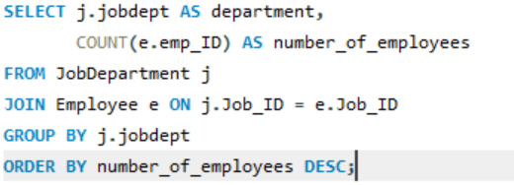
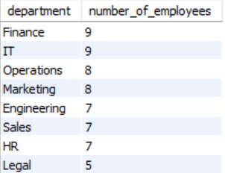
Which departments have the highest number of employees?
INSIGHT
Finance and IT have the highest employee count, indicating strong focus on technical and financial operations.
CONCLUSION
The workforce distribution is balanced, with core departments receiving greater staffing support.

Slide 10
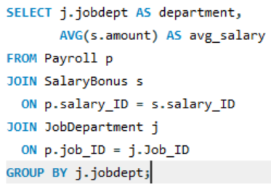
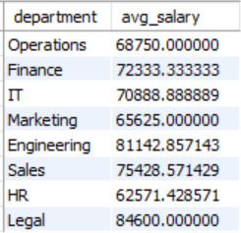
What is the average salary per department?
INSIGHT
Legal has the highest average salary, followed by Engineering and Sales, indicating higher compensation in specialized roles.
CONCLUSION
Salary distribution varies significantly across departments, with technical and specialized domains receiving higher average pay.

Slide 11
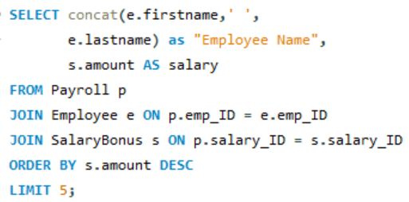
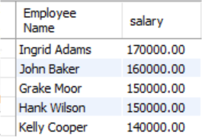
Who are the top 5 highest-paid employees?
INSIGHT
Ingrid Adams is the highest-paid employee, followed by John Baker, with top salaries concentrated among a few individuals.
CONCLUSION
The salary structure shows a clear compensation hierarchy, with significant pay differences among top-performing employees.

Slide 12
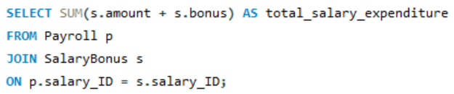

What is the total salary expenditure across the company?
INSIGHT
The company’s total salary expenditure including bonuses amounts to 4,951,700, reflecting overall compensation cost.
CONCLUSION
Employee compensation represents a significant financial commitment, highlighting the importance of effective payroll and budget management

Slide 13
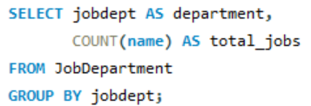
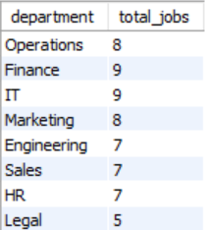
2. JOB ROLE AND DEPARTMENT ANALYSIS
How many different job roles exist in each department?
INSIGHT
Finance and IT have the highest number of job roles (9 each), indicating broader functional diversity in these departments.
CONCLUSION
Departments like Finance and IT show greater role specialization, while Legal has the least structural complexity.

Slide 14
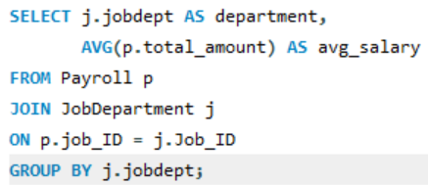
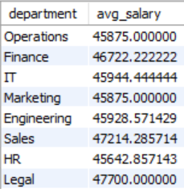
What is the average salary range per department?
INSIGHT
Legal and Sales have the highest average salary range, while HR has the lowest among departments.
CONCLUSION
Salary distribution is relatively balanced across departments, with slight variations reflecting role complexity and responsibility levels.

Slide 15
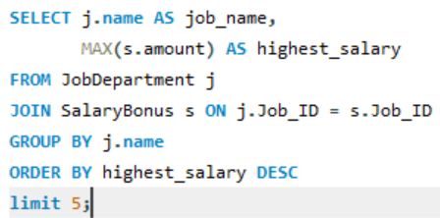
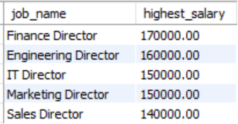
Which job roles offer the highest salary?
INSIGHT
The Finance Director role has the highest salary (170,000), followed by other Director-level positions, indicating top-tier compensation at leadership levels.
CONCLUSION
Salary structure is strongly hierarchical, with senior management roles receiving significantly higher pay than other positions.

Slide 16
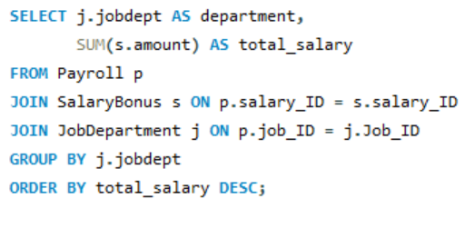
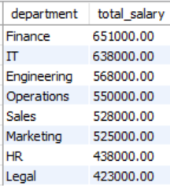
Which departments have the highest total salary allocation?
INSIGHT
The Finance department has the highest total salary allocation, followed closely by IT, indicating major investment in financial and technical operations.
CONCLUSION
Budget distribution shows that core operational departments receive the largest share of compensation spending, reflecting their strategic importance.

Slide 17
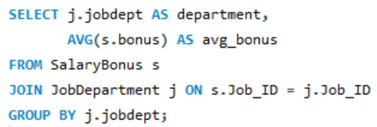
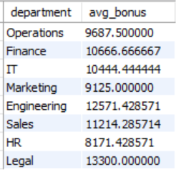
5. PAYROLL AND COMPENSATION ANALYSIS
What is the average bonus given per department?
INSIGHT
Legal and Engineering departments have the highest average bonus, indicating stronger performance-based incentives in specialized roles.
CONCLUSION
Bonus distribution varies across departments, with technical and high-responsibility areas receiving higher incentive compensation.

Slide 18
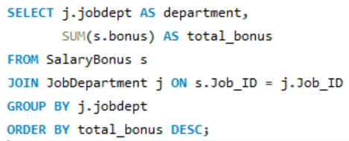
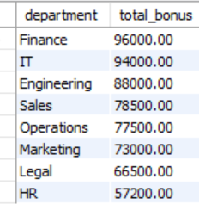
Which department receives the highest total bonuses?
INSIGHT
The Finance department has the highest total bonus allocation, followed by IT, indicating stronger incentive payouts in core operational areas.
CONCLUSION
Bonus distribution reflects the company’s performance priorities, with major departments receiving the largest share of incentive rewards.

Slide 19
Challenges Faced
Defining accurate table relationships and implementing proper primary and foreign key constraints to maintain referential integrity.
Ensuring data consistency and integrity while handling cascading updates and deletes across interrelated tables.
Writing complex multi-table JOIN queries for reports involving employee roles, salary, leaves, and payroll calculations.
Preventing duplicate records by enforcing UNIQUE constraints, particularly on critical fields such as employee email IDs.

Slide 20
Final Business Insights
The Finance and IT departments have the highest employee strength and salary allocation, indicating their strategic importance to the organization.
Director-level and senior management roles receive the highest compensation, reflecting a clearly defined hierarchical pay structure.
The Legal and Engineering departments show higher average salaries and bonuses, suggesting specialized expertise commands premium compensation.
Overall payroll analysis reveals that salary and bonus expenditures represent a major financial commitment, emphasizing the need for efficient budget management.
Workforce and compensation distribution are balanced but strategically prioritized, aligning resources with core operational and revenue-driving departments.

Slide 21
RECOMMENDATIONS
Optimize salary and bonus allocation by regularly analyzing department-wise payroll trends to ensure cost efficiency.
Focus on strengthening core departments (Finance and IT) through strategic workforce planning and skill development.
Implement periodic reviews of leave patterns and compensation structures to improve productivity and resource utilization.
Use data-driven insights to support performance-based incentives, budgeting decisions, and long-term HR planning.

Slide 22
Conclusion
The Employee Management System provides structured insights into workforce distribution, salary allocation, bonuses, and payroll trends.
The analysis highlights a clear hierarchical compensation structure and strategic investment in core departments, supporting data-driven HR and financial decision-making.

Slide 23


Slide 24

THANK YOU

